Slide 1
PROJECT PRESENTATION
ONLINE SALES DATASET

Slide 2
DESCRIPTION ABOUT DATA
The Online Sales Dataset contains transactional data collected from an e-commerce platform. It records details of customer purchases made through an online website over a specific time period. The dataset helps analyze sales performance, customer's review rating and product demand

Slide 3
PROCESS
First we can checked the information of the dataset regarding their feature, datatype and null value.
Checked the unique features
Checked duplicates for the features.
EDA-In this process we segmented and segregated the features and framed questions.
After segmentation we grouped the questions accordingly, we visualize for better understanding.

Slide 4
WORKFLOW OF DATA ANALYSIS
COLLECTION OF DATA
UNDERSTANDING DATA AND BUSINESS PROBLEM
DATA CLEANING
DATA TRANSFORMATION
EXPLORATORY DATA ANALYSIS
DATA VISUALIZATION
PRESENT FINAL INSIGHTS

Slide 5
1. collection of data
Collected this data from Kaggle by checking their rows , columns and null values.
Downloaded in CSV format .
2.UNDERSTANDING DATA AND BUSINESS PROBLEM
The dataset includes customers personal details like Customer id , State and Country
It contains product information like Product Category, Product Name, Quantity, Total Sales INR,
Unit Price INR
Payment details like Payment Method, Delivery Status, Review Rating , Review Text

Slide 6
DATA CLEANING
Checked for null values - No null values
Checked for duplicates - No duplicates
(ordered id & customer id)
Checked for unique features - Each has it’s own unique
Checked rows and columns - ROWS-15000 COLUMNS-13
data transformation
Dataset prepared for analysis.
Features made easier to understand and compare.
Ready for visualization and further analysis.

Slide 7
exploratory data analysis
To understand data patterns & trends.
Improve the sales performance by customers review rating and
this analysis transaction records , Payment method &which product sales highest
segmentation analysis
CUSTOMERS BASED ANALYSIS
PRODUCT BASED ANALYSIS
PAYMENT BASED ANALYSIS
REGION BASED ANALYSIS
DATE WISE ANALYSIS

Slide 8
CUSTOMERS BASED ANALYSIS

Slide 9
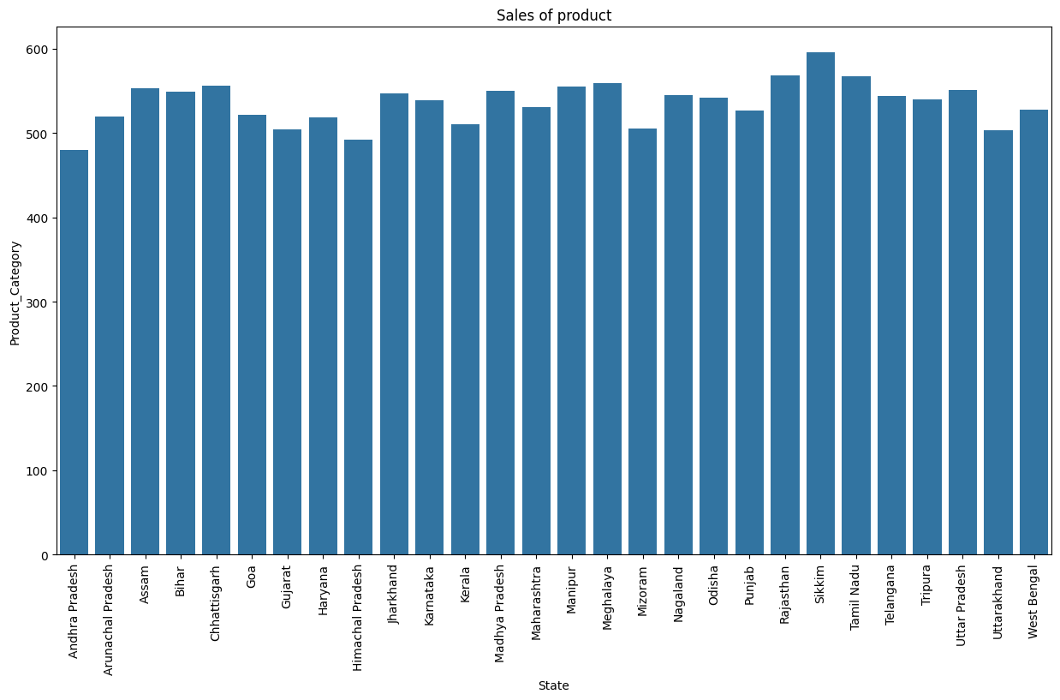
In that 28 state Sikkim has the highest product sales at about 596 ,followed by Rajasthan has the second
Highest product sales at about 568 and Others are average between 500 to 550 . Andhrapradhesh has
Least product sales at about 480

Slide 10
PRODUCT BASED ANALYSIS

Slide 11
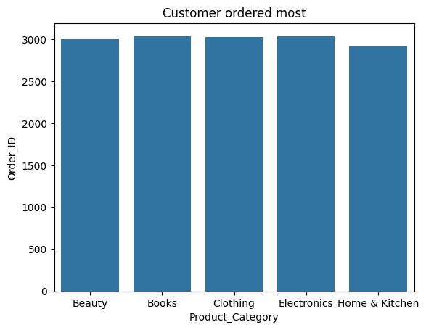
In that 5 product Electronic product has most ordered by customers at about 3036,
followed by Books has also most ordered by customers at about 3035, Beauty
product has ordered about 2995, Clothing product has ordered at about3022,
Home & Kitchen product has least ordered by customer at about 2910

Slide 12
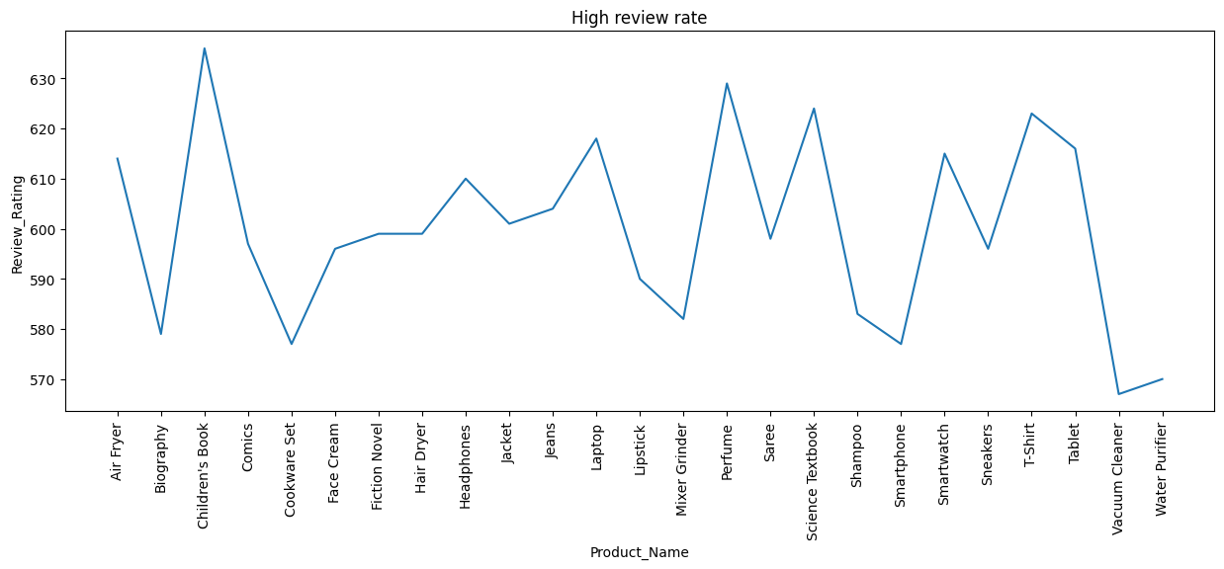
Children's book has the highest review rate at about
636, Vacuum cleaner has the most lowest review rate
At about 567 ,Others are average between 570 to 620

Slide 13
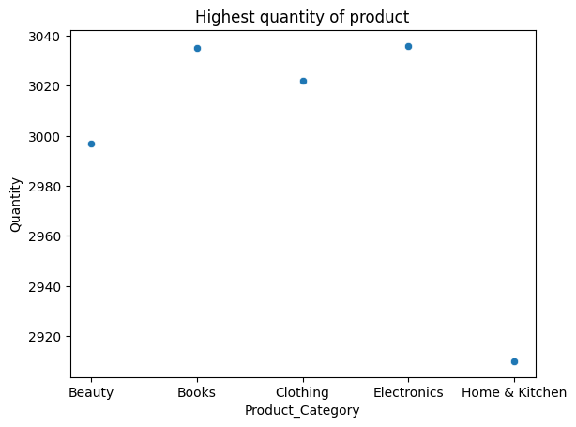
Books and Electronics have highest quantity of product at about 3036 & 3035,
Beauty product has about 2997,Clothing product has about 3028,Home&Kitchen
product has 2910.

Slide 14
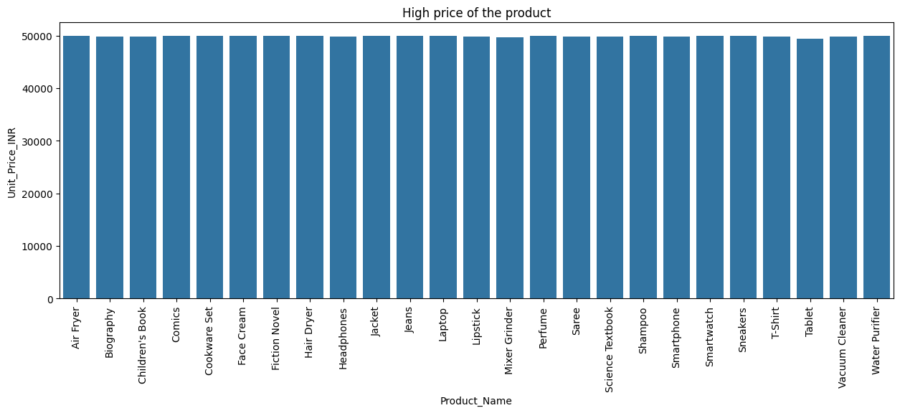
Sneakers has highest unit price at about 49994.43,
Water purifier also have high unit price compare to others at about 49991.10, Mixer grinder has most least unit price at about 49664.09

Slide 15
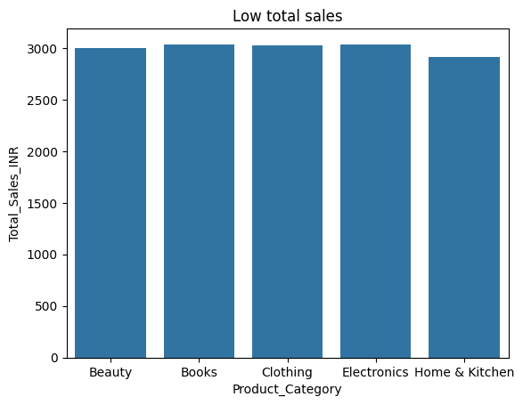
Home & Kitchen has the lowest total sale at About 2910,Electronics has highest total sale at
About 3036.

Slide 16
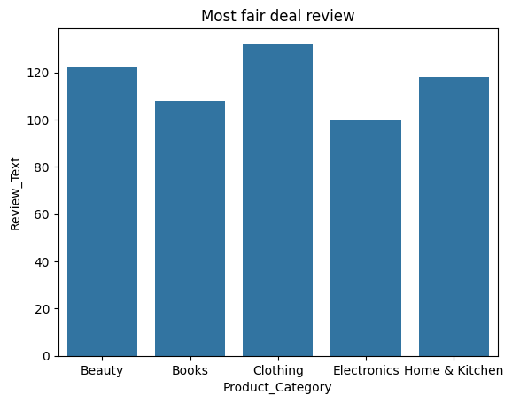
Clothing product has the most fair deal at about 132 review text , Electronics product has least fair deal at about 100 review text , Books has about 108 review text , Beauty product has about 122 review text, Home & Kitchen has about 118 review text

Slide 17
PAYMENT BASED ANALYSIS

Slide 18
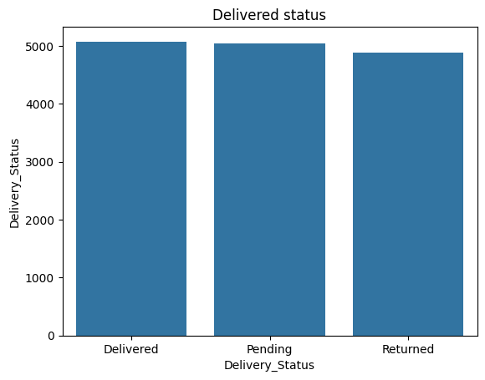
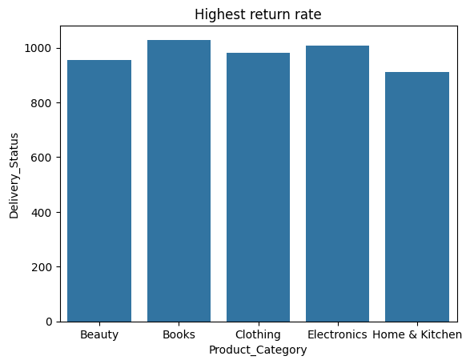
* 5075 Product has delivered
* 4881 product has returned
* 5044 product has pending
1029 Books were returned
Second highest 1006 Electronics were returned

Slide 19
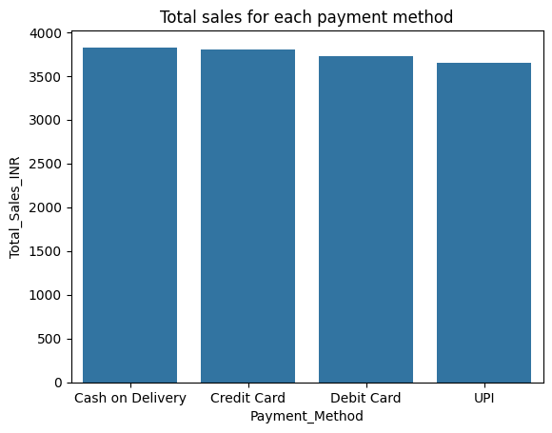
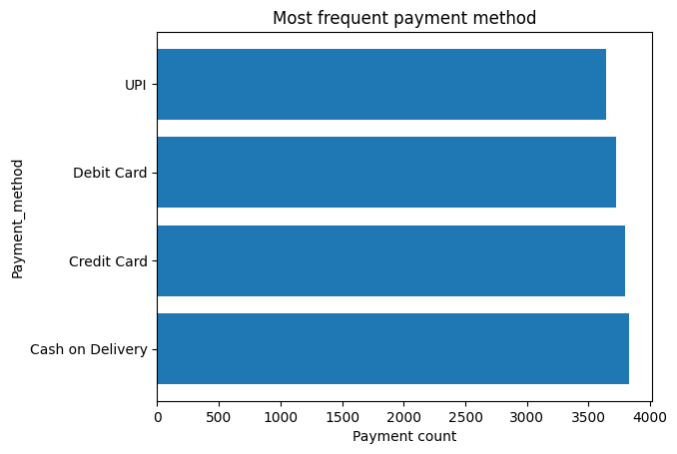
Most frequent payment method is cash on delivery
at 3827
3800 Customer pay through credit card
3727 Customer pay through debit card
3646 Customer pay through upi
Cash on delivery has the high total sales at 3827
Credit card has the second largest total sales
compare to others at 3800,UPI has least total sales at
3646

Slide 20
DATE WISE ANALYSIS

Slide 21
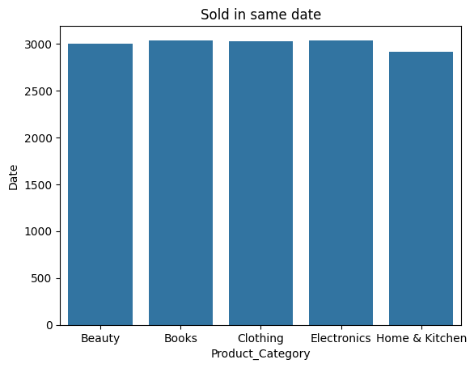
* 2997 Beauty Product can sold in same date
* 3035 Books product can sold in same date
* 3022 Clothing product can sold in same date
* 3036 Electronic product can sold in same date
* 2910 Home & Kitchen product can sold in same date

Slide 22
FINAL INSIGHTS

Slide 23
We perform product-based, payment-based, and overall sales analysis to transform raw sales
data into meaningful business decisions. These processes help organizations like ,
1. Improve Decision-Making
2. Identify Top & Weak Performers
3. Understand Customer Behavior
4. Which product has Demand
I recommended focusing on high-revenue product categories, encouraging digital payments, improving delivery
efficiency, leveraging customer reviews for quality improvements, and targeting high-potential regions.
“Improving logistics and focusing on high-value customers can significantly increase revenue and satisfaction
to improve overall business performance.”

Slide 24
THANKYOU

